Slide 1
Digital portfolio Front-END web development
NAME : Aswin kumar. K
NM ID : 𝐚𝐬𝐚𝐧𝐦10824131081802521016
Reg no : 24131081802521016
Department : computer science
College : Thiru kolanjiappar government arts college
University: ANNAMALAI UNIVERSITY

Slide 2
Problem statement
In today’s competitive world, having an online presence is crucial for showcasing skills, projects, and achievements. Traditional resumes often lack interactivity and design appeal, making it harder to stand out.A digital portfolio solves this by providing a centralized, creative, and interactive platform where individuals can highlight their expertise, display projects, and enable potential employers/clients to easily connect.

Slide 3
Project overview
This project is a personal digital portfolio website designed and developed using HTML, CSS, and JavaScript.The website highlights the developer’s skills, projects, and contact information in a clean, responsive, and visually engaging layout. It also includes animations, gradient UI elements, and interactive components for a modern user experience.

Slide 4
End users
Recruiters / Hiring Managers – to evaluate the developer’s front-end skills.Clients / Freelancers – to explore past work and initiate collaborations.Peers & Developers – to share knowledge and inspiration.Personal Branding – to create an online identity and showcase technical expertise.

Slide 5
Tools and Technologies
HTML5 → Structure and semantic layoutCSS3 (with Flexbox & Grid) → Styling, responsiveness, and layout designJavaScript (ES6+) → Interactivity, smooth scrolling, form handling, and toast notificationsGoogle Fonts (Inter, Poppins) → Clean and modern typographySVGs & Gradient Backgrounds → Visual creativityPicsum API (Random Images) → Demo placeholder images

Slide 6
Portfolio Design and Layout
Navigation Bar → Sticky, multi-color gradient navbar with smooth scroll linksHero Section → Introductory section with name, tagline, call-to-action buttons, and creative mockup illustrationAbout Section → Brief background and creative SVG image maskSkills Section → Showcasing technical skills in chips with color-coded highlightsProjects Section → Cards with images, tags, and live demo placeholdersContact Section → Email form with JavaScript handler + contact detailsFooter → Copyright and credits

Slide 7
Features and Functionality
Responsive design (works on desktop, tablet, and mobile)Animated gradient navigation barInteractive hamburger menu for small screensSmooth scrolling to sectionsToast notification system for feedbackContact form that auto-opens the user’s email clientRandomized placeholder images for creativityElegant color palette with gradient effects

Slide 8
Results and Screenshots
Fully functional, responsive digital portfolio
✔ Smooth animations and interactivity
✔ Professional, modern layout design

Slide 9
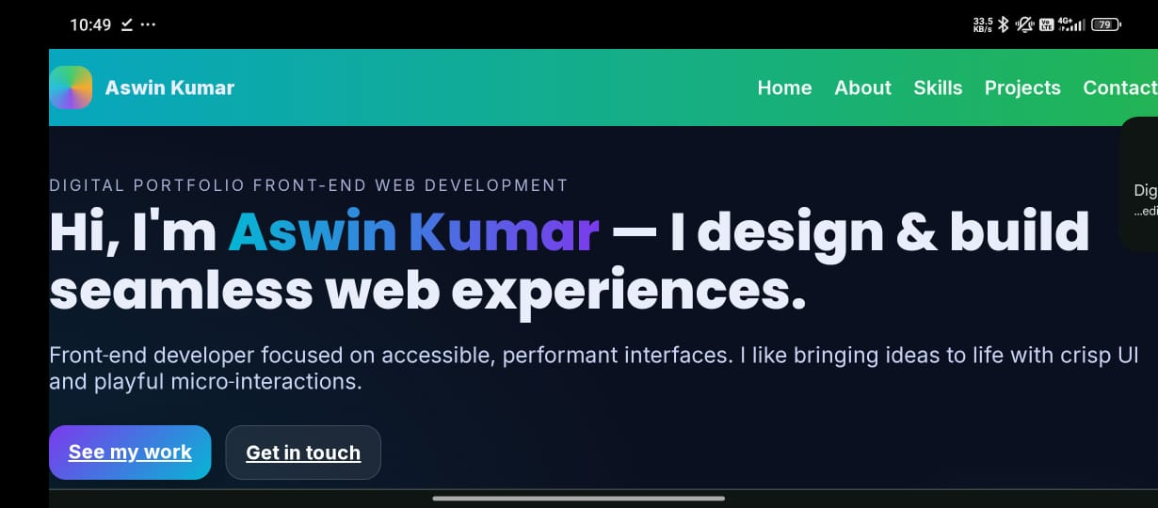

Slide 10
Conclusion
The project successfully demonstrates front-end development skills using core web technologies. It provides a professional and interactive way to present personal achievements, skills, and projects.This portfolio not only helps in personal branding but also enhances the developer’s ability to showcase creativity and coding expertise in real-world scenarios.

